Slide 1
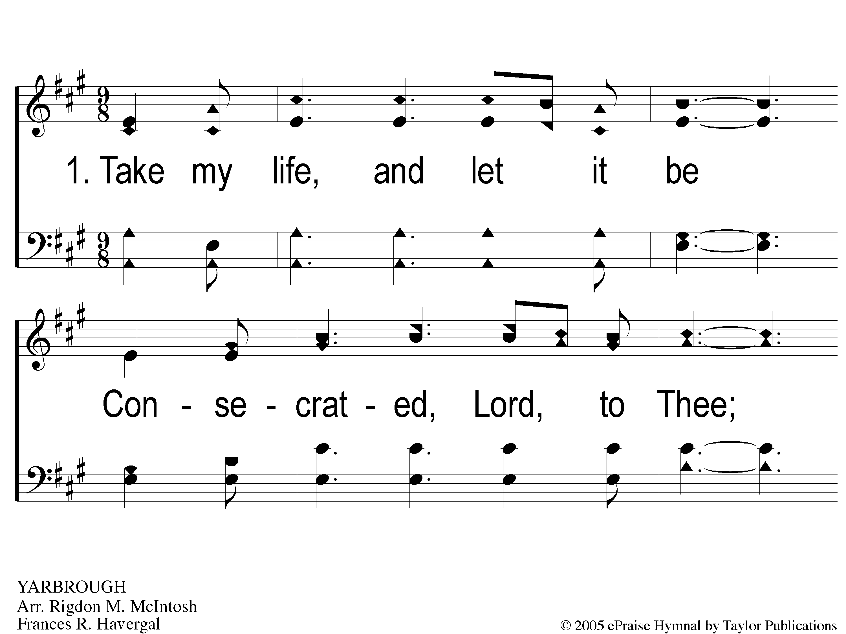
1-1 Take My Life And Let It Be
Take My Life And Let It Be
111

Slide 2
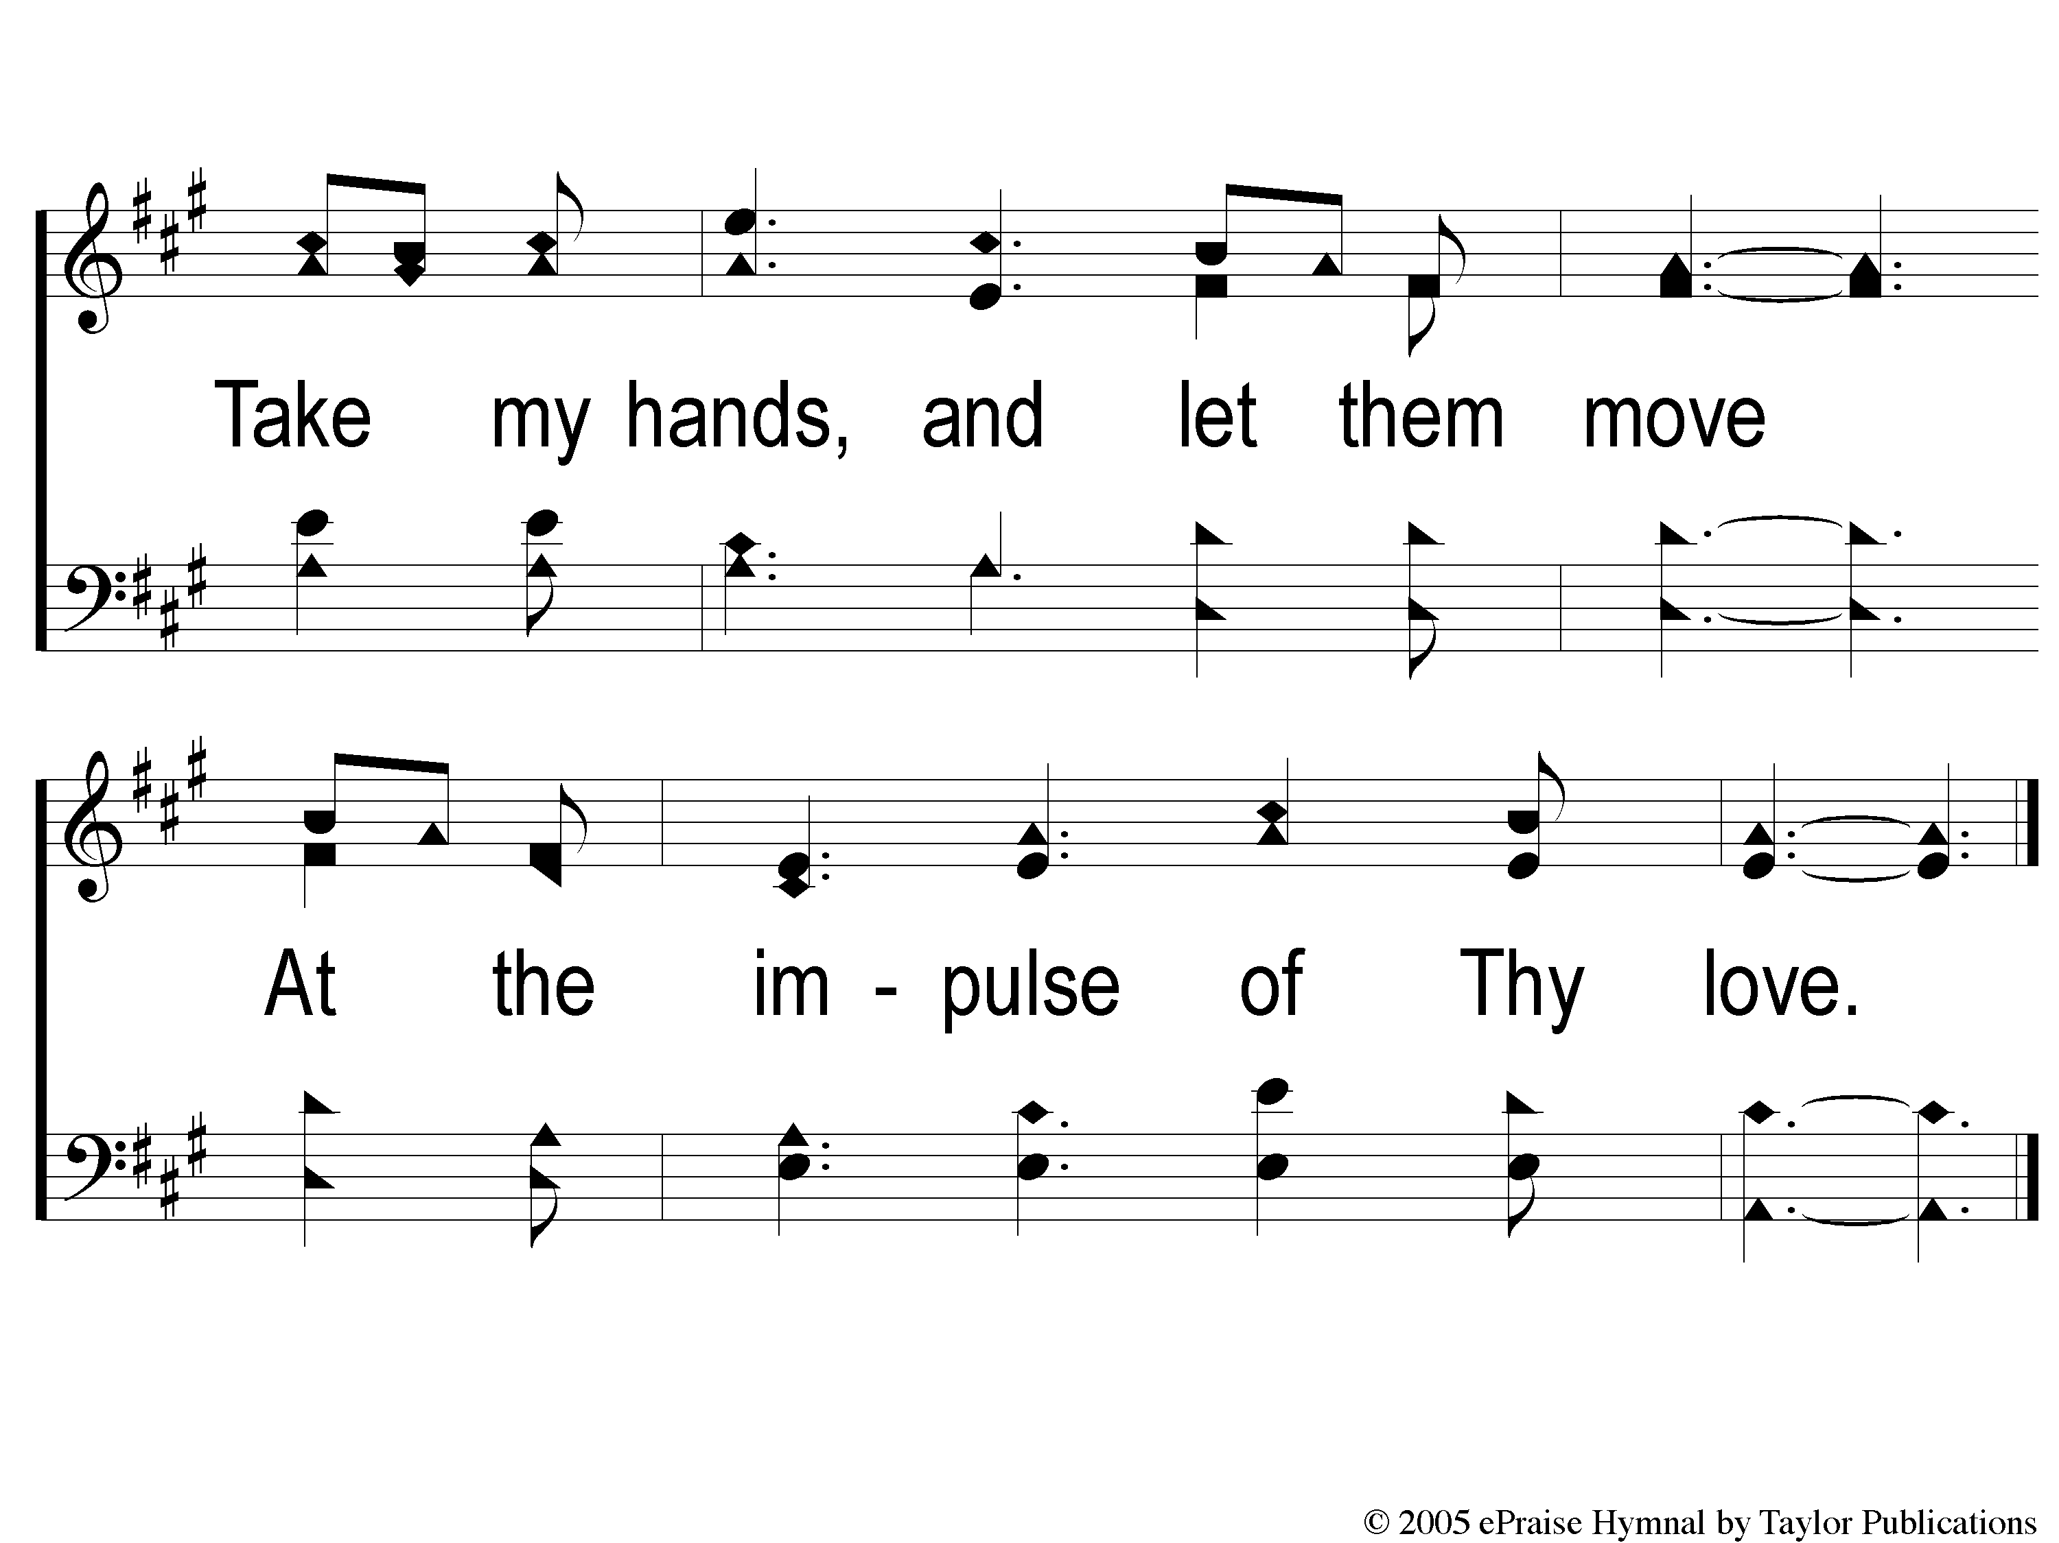
1-2 Take My Life And Let It Be
Take My Life And Let It Be
111

Slide 3
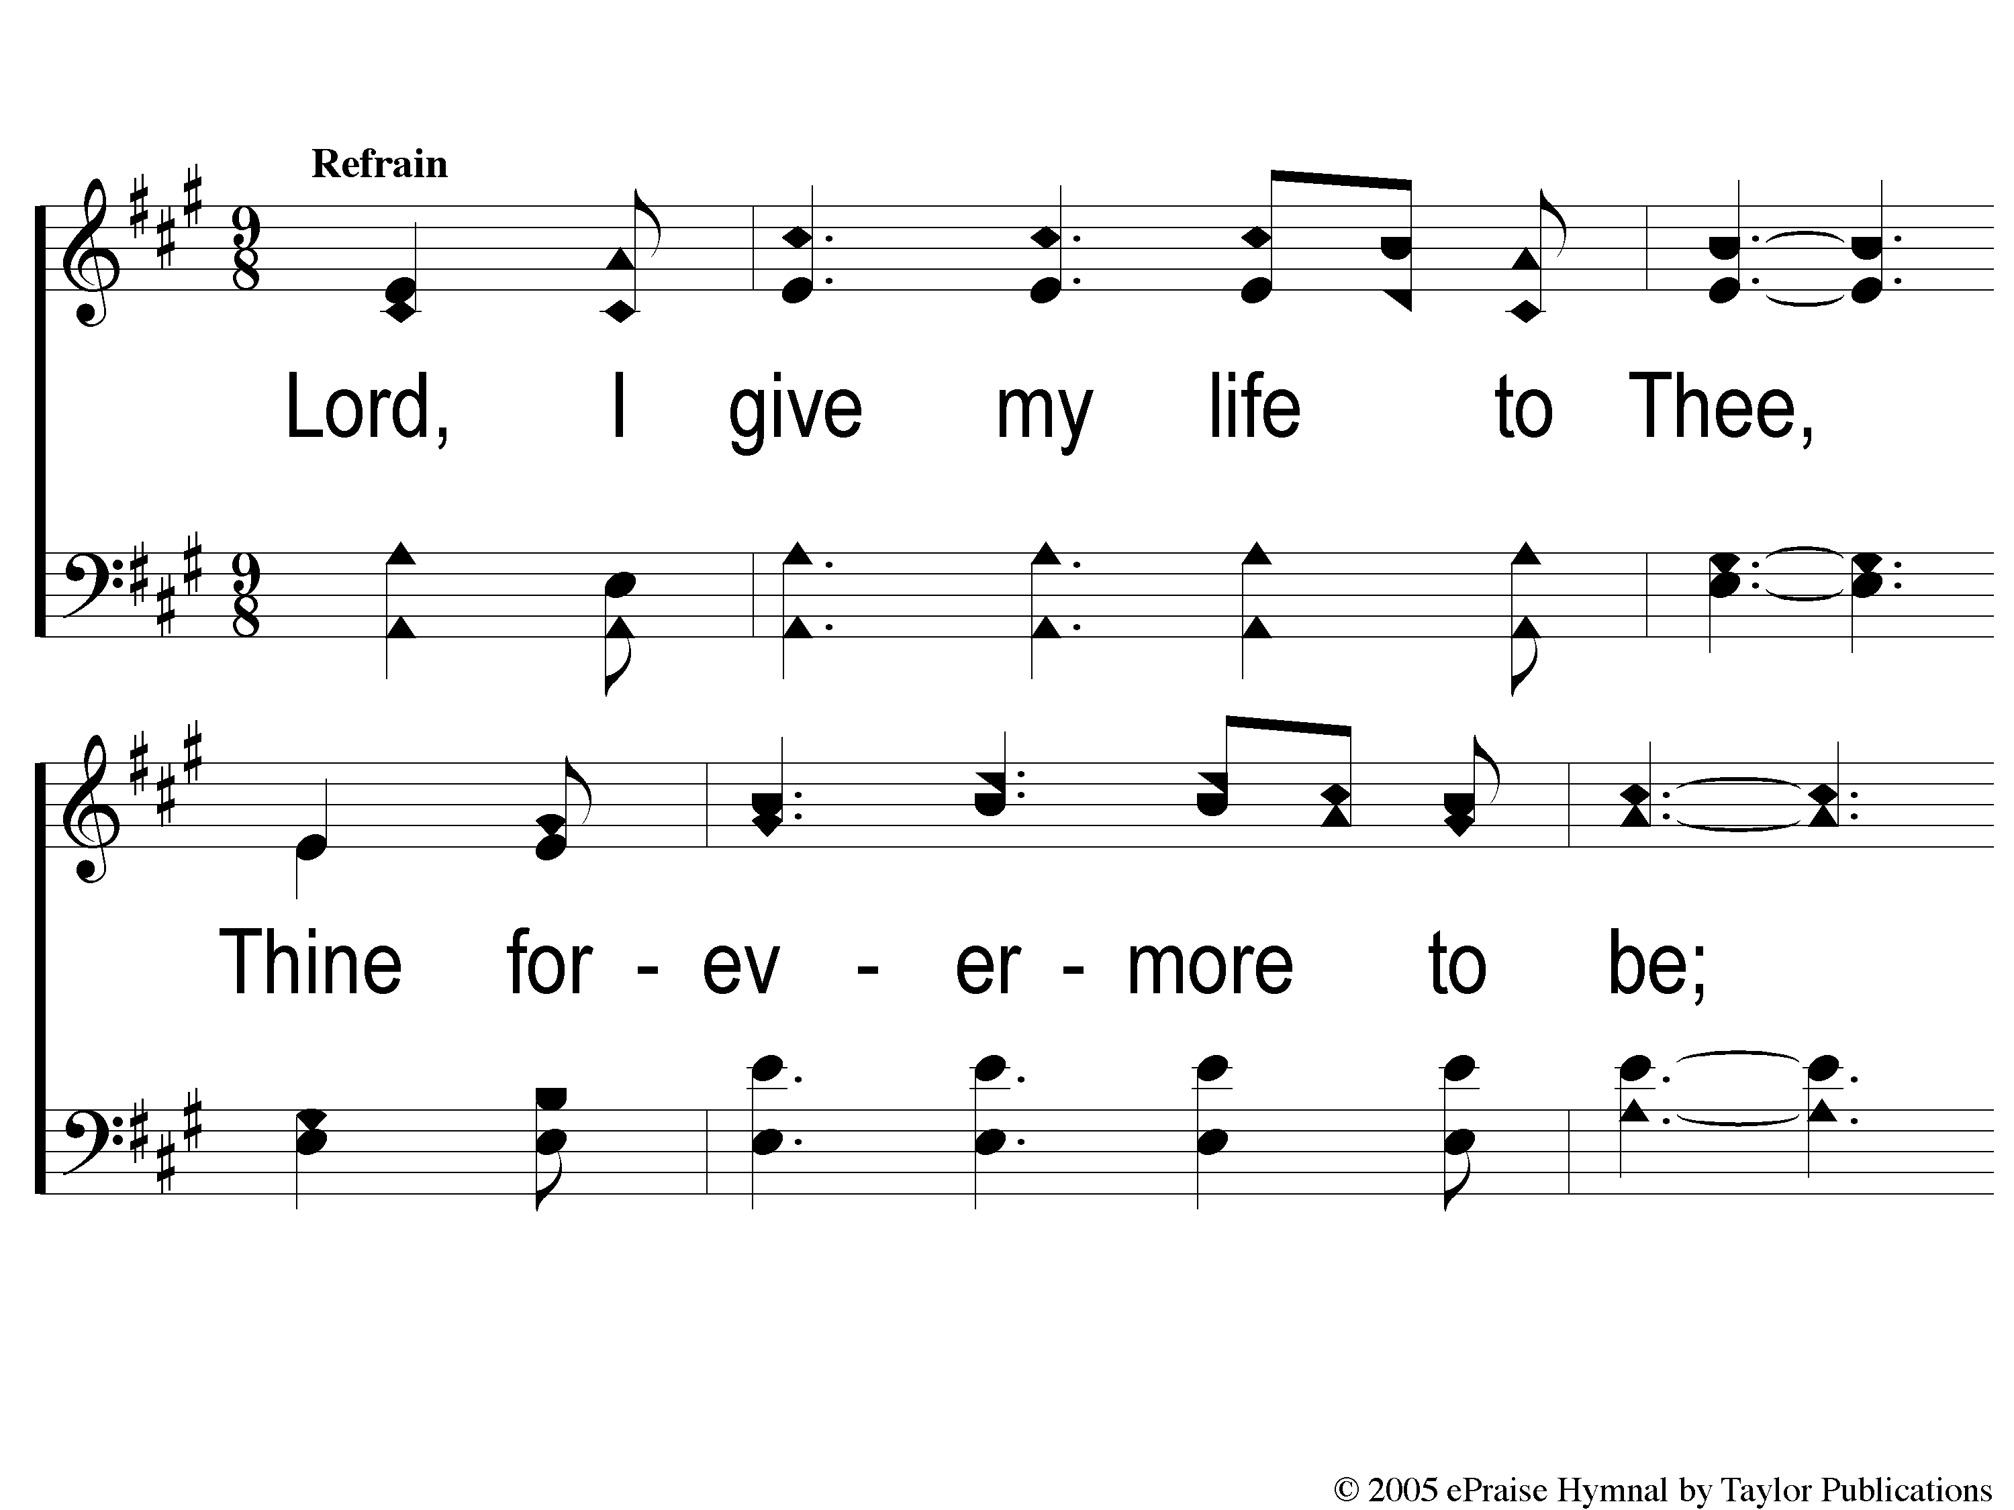
C-1 Take My Life And Let It Be
Take My Life And Let It Be
111

Slide 4
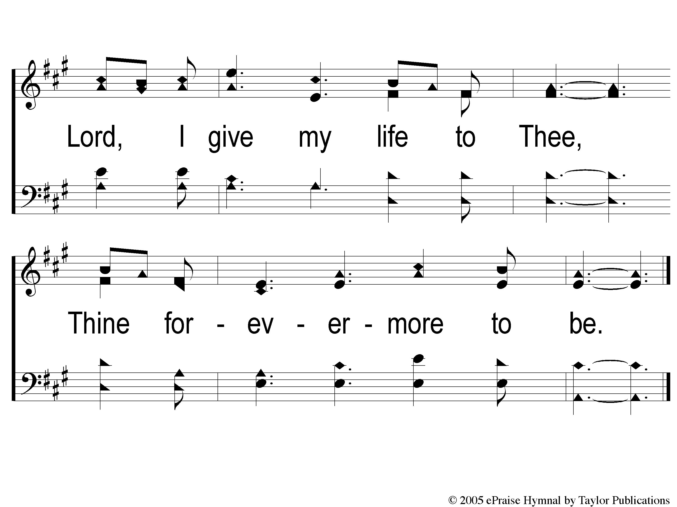
C-2 Take My Life And Let It Be
Take My Life And Let It Be
111

Slide 5
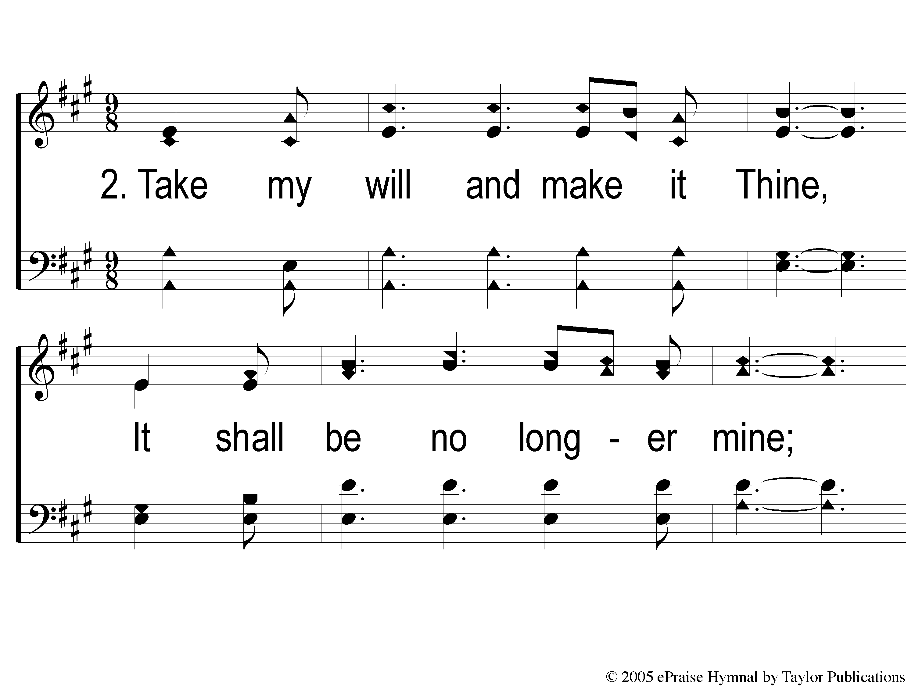
2-1 Take My Life And Let It Be
Take My Life And Let It Be
111

Slide 6
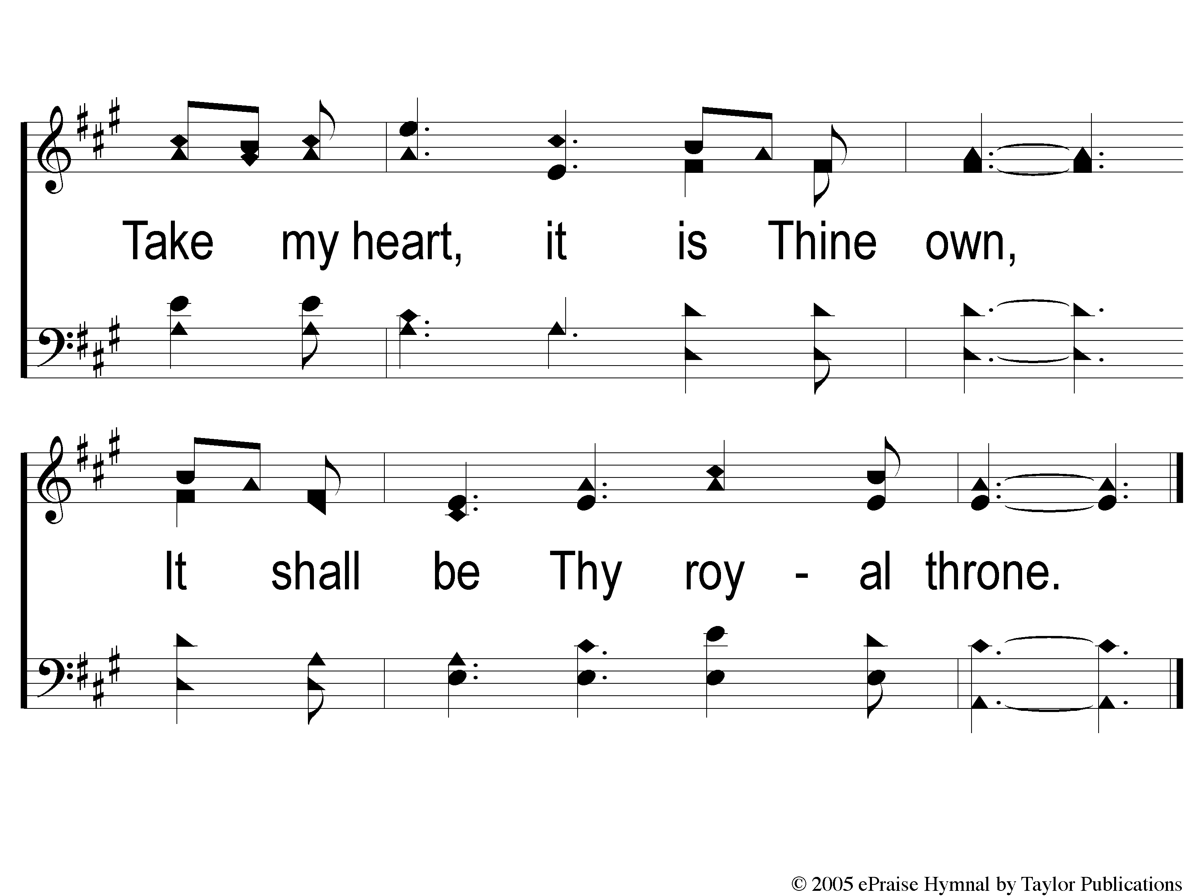
2-2 Take My Life And Let It Be
Take My Life And Let It Be
111

Slide 7
C-1 Take My Life And Let It Be
Take My Life And Let It Be
111

Slide 8
C-2 Take My Life And Let It Be
Take My Life And Let It Be
111

Slide 9
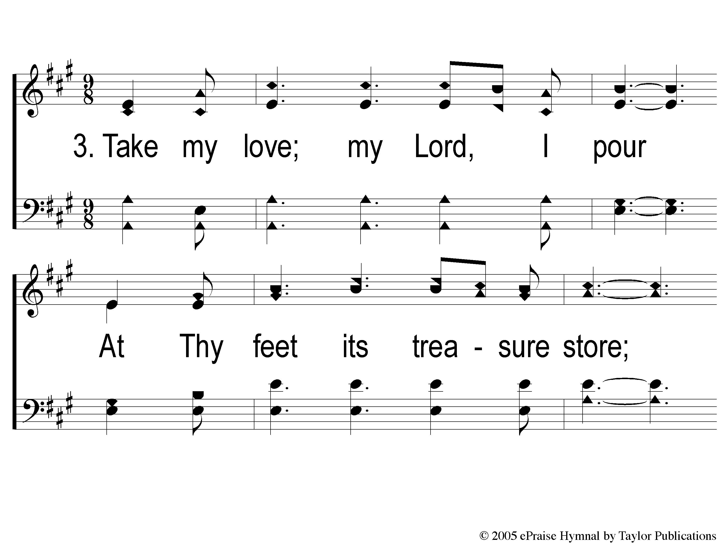
3-1 Take My Life And Let It Be
Take My Life And Let It Be
111

Slide 10
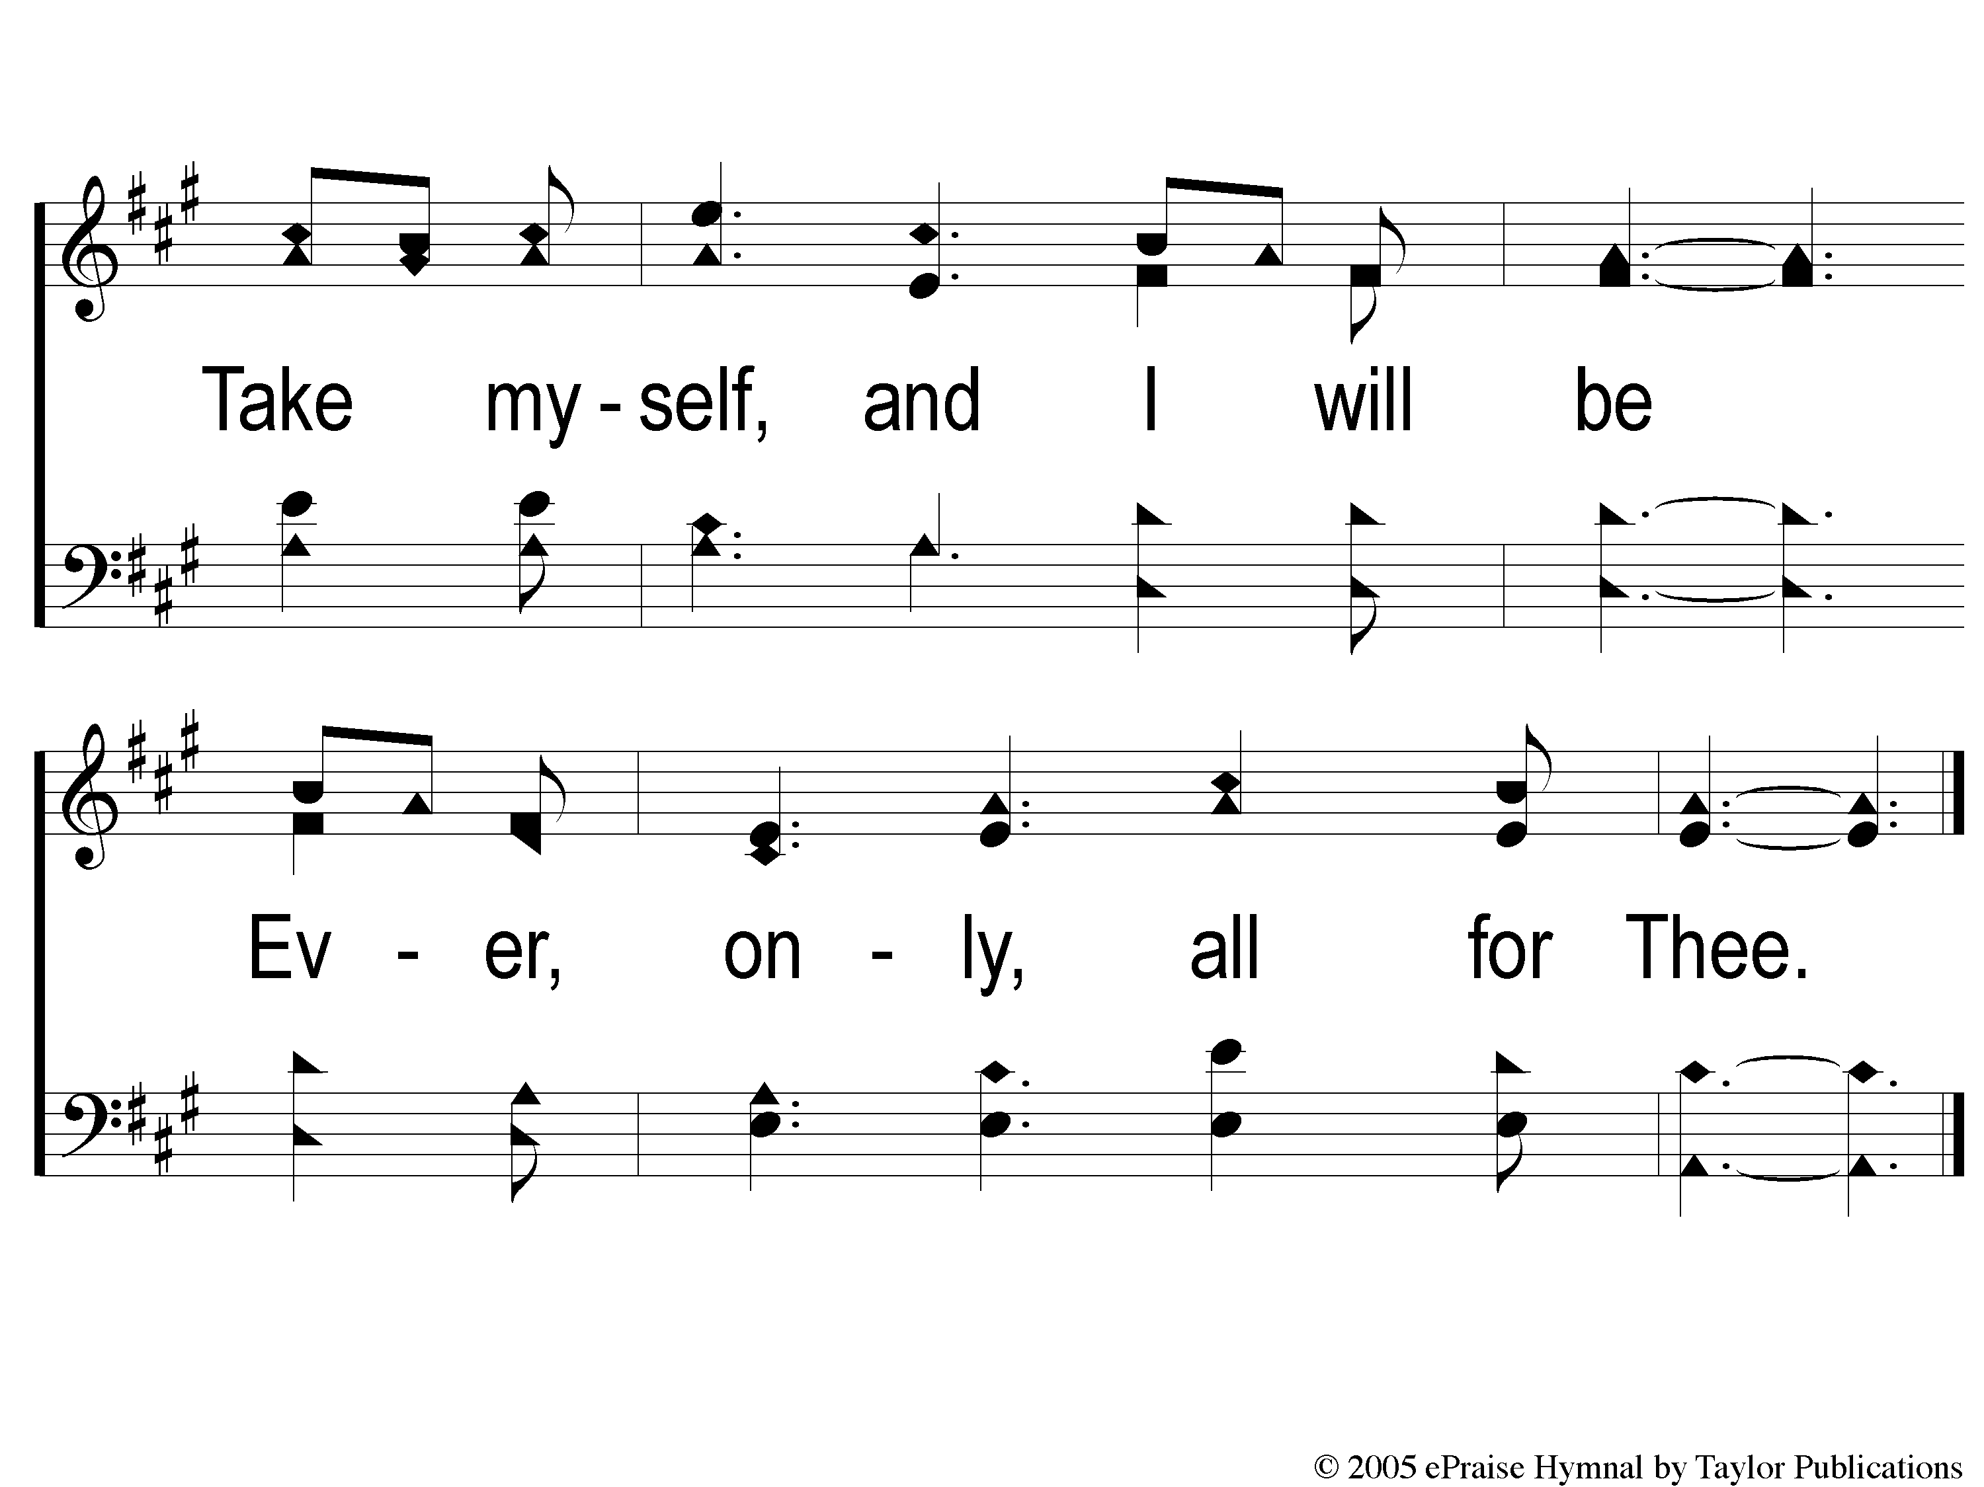
3-2 Take My Life And Let It Be
Take My Life And Let It Be
111

Slide 11
C-1 Take My Life And Let It Be
Take My Life And Let It Be
111

Slide 12
C-2 Take My Life And Let It Be
Take My Life And Let It Be
111

